Slide 1

REVIEW
15 MIN
HOMEWORK REVIEW
CORRECTION / DEMO

Slide 2

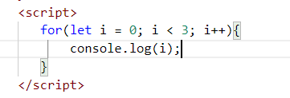
What will the console display?
0123 b. 123
c. 0
1
2
d. I don’t know
Notes:
c

Slide 3
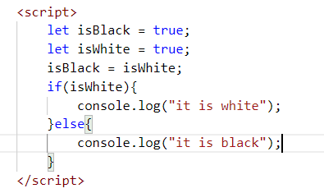
What will the console display?
it is white b. it is black
c. I don’t know
d. Error
Notes:
a

Slide 4
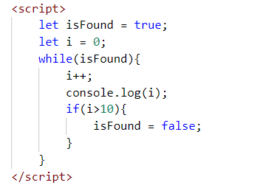
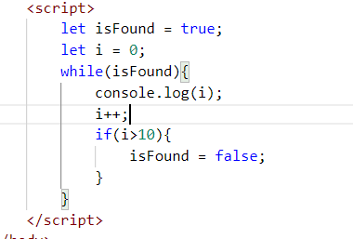
Do they have the same output?
A. Yes
B. No
Notes:
b

Slide 5
What will the console display?
Notes:
1-10

Slide 6
Do they have the same output?
Notes:
1-11

Slide 7
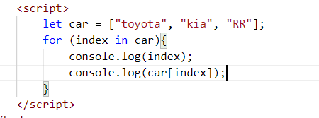
What will the console display?
Notes:
0
Toyota
1
Kia
2
RR

Slide 8
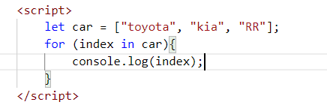
What will the console display?
Notes:
0
1
2

Slide 9
CHAPTER 1
PYTHON to JS
PART 2
Variables

Slide 10

OBJECTIVES FOR TODAY
The different ways to loop
The difference between = and == and ===
Scope of variables
Difference between let and const

Slide 11
EXPLAIN
LOOP BY RANGE OF INDEX
15 MIN
1- Create
index
2- Condition to
Stop the loop
3- Increment
the index
for (let index = 0; index < 10 ; index++) {
console.log(index)
}
We loop 10 time !

Slide 12
EXPLAIN
LOOP BY INDEX
LOOP BY VALUE
for (let index in array) {
}
for (let value of array) {
}

Slide 13
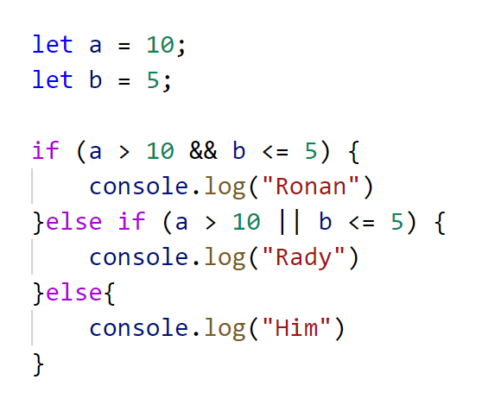
What will the console display?
A.
B.
C.
D.
Ronan
Rady
HIM
Error
Notes:
b

Slide 14
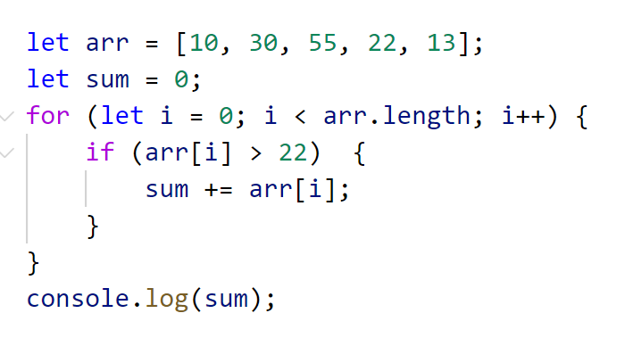
What will the console display?
A.
B.
C.
D.
85
98
50
Error
Notes:
a

Slide 15
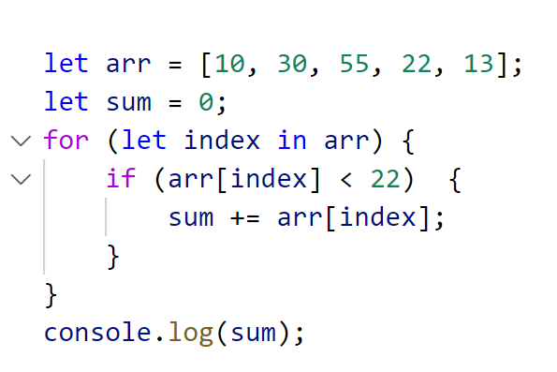
What will the console display?
A.
B.
C.
D.
85
98
23
Error
Notes:
c

Slide 16
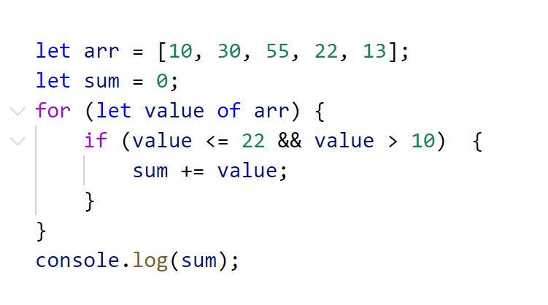
What will the console display?
A.
B.
C.
D.
85
35
23
Error
Notes:
b

Slide 17
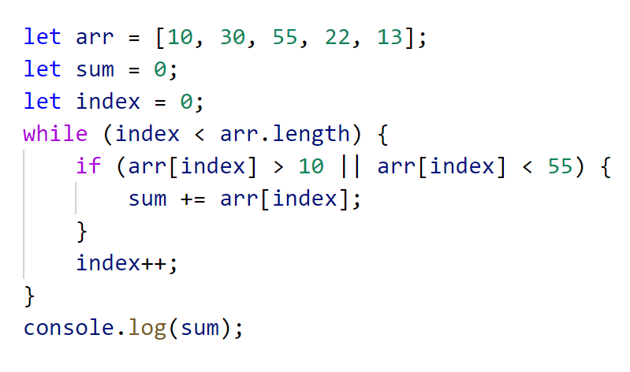
What will the console display?
A.
B.
C.
D.
120
35
130
Error
Notes:
c

Slide 18
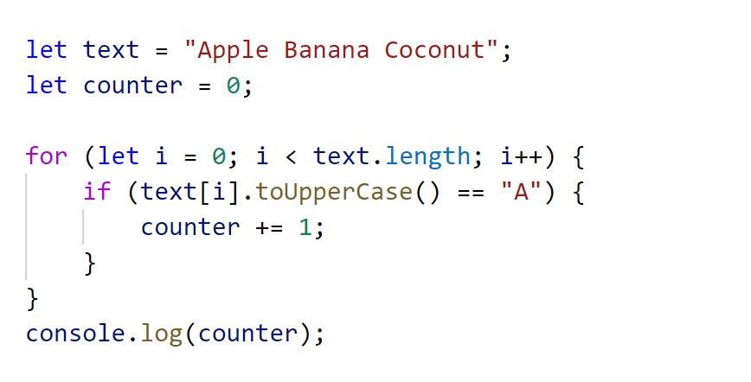
What will the console display?
A.
B.
C.
D.
3
4
5
Error

Slide 19
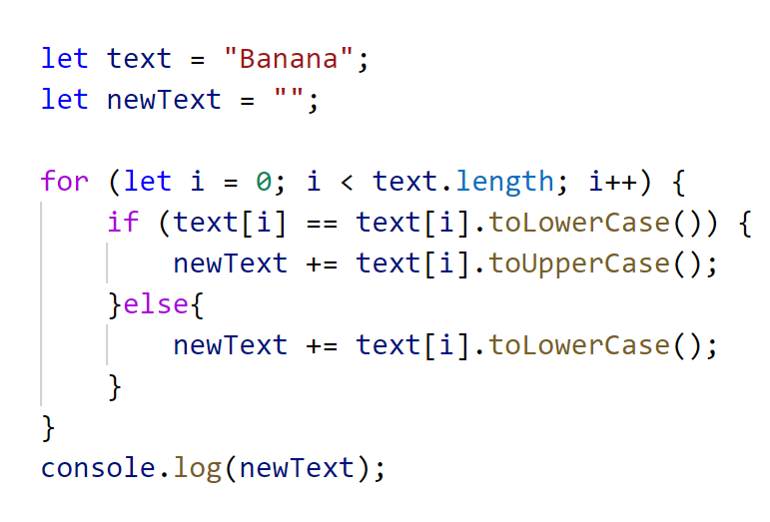
What will the console display?
A.
B.
C.
D.
BANANA
Banana
bANANA
Error

Slide 20
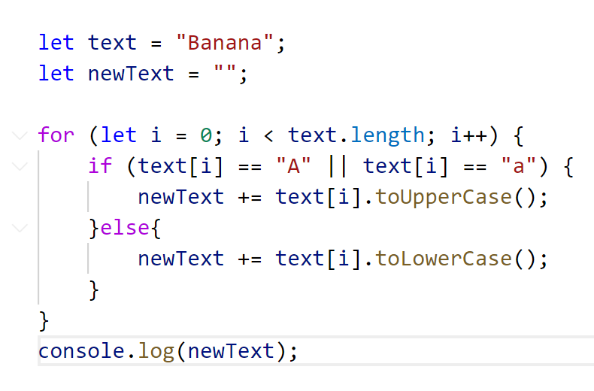
What will the console display?
A.
B.
C.
D.
bAnAnA
Banana
BaNaNa
Error

Slide 21
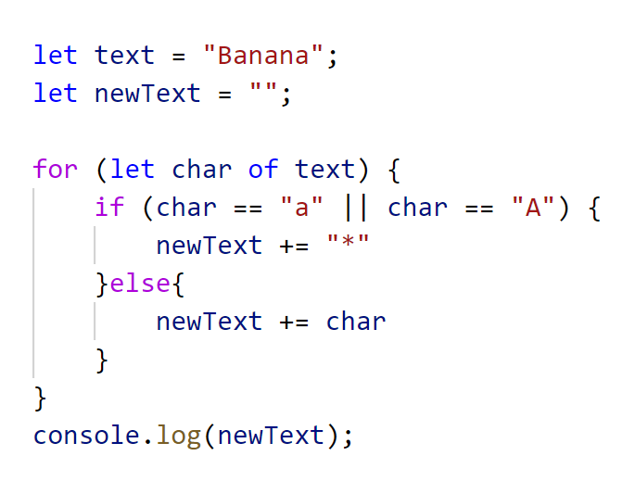
What will the console display?
A.
B.
C.
D.
bAnAnA
B*n*n*
BaNaNa
Error

Slide 22
What will the console display?
let fourAsNumber = 4;
let fourAsString = "4";
console.log(fourAsNumber == fourAsString);

Slide 23
What will the console display?
let fourAsNumber = 4;
let fourAsString = "4";
console.log(fourAsNumber === fourAsString);
Yes !! 3 = !!

Slide 24
EXPLAIN
YOU SHOULD
(almost) ALWAYS
USE ===
Yes !! 3 = !!

Slide 25
What will the console display?
let x = 16 + “volvo“
console.log(x)
A
B
C
D
16
16volvo
Syntax error
Runtime error

Slide 26
What will the console display?
let x = 4 + 16 + “Volvo”
console.log(x)
A
B
C
D
20Volvo
416Volvo
Syntax error
Runtime error

Slide 27
What will the console display?
let x = "Volvo" + 4 + 16;
console.log(x);
A
B
C
D
Volvo20
Volvo416
Syntax error
Runtime error

Slide 28
What will the console display?
let carName;
console.log(carName);

Slide 29
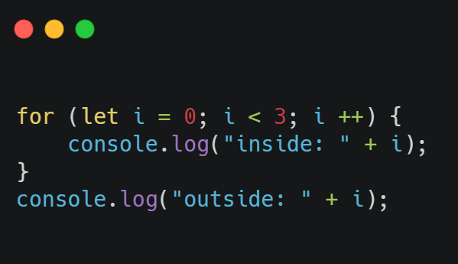
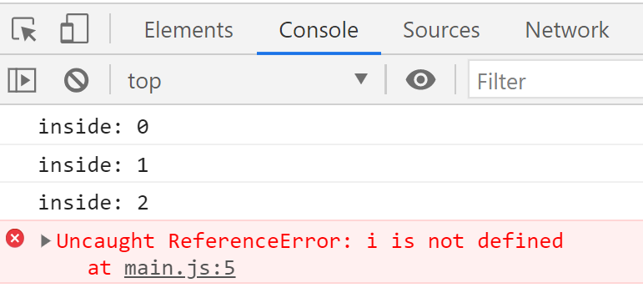
EXPLAIN
Scope of variable
A variable declared with let have block scope
The variables I is declared inside a block {} so it cannot be accessed from outside the block.

Slide 30
What will the console display?
let x = 4
x = 5
console.log(x)
A
B
C
D
4
5
Syntax error
Runtime error
Notes:
b

Slide 31
What will the console display?
let x = 4
if (x > 3) {
let sum = 0;
sum += 5
}
console.log(sum)
A
B
C
D
4
9
Syntax error
Runtime error
Notes:
d

Slide 32
What will the console display?
let x = 7;
if (x > 4) {
let sum = 0;
sum += 5;
} else {
sum += 10;
console.log(sum)
}
A
B
C
D
Nothing
15
Syntax error
Runtime error
Notes:
a

Slide 33
What will the console display?
let x = 7;
if (x < 4) {
let sum = 0;
sum += 5;
} else {
sum += 10;
console.log(sum)
}
A
B
C
D
Nothing
15
10
Runtime error
Notes:
d

Slide 34
What will the console display?
for (let i = 0; i < 3; i++) {
let total = 0;
total += i
}
console.log(total)
A
B
C
D
Nothing
8
Syntax error
Runtime error
Notes:
d

Slide 35
What will the console display?
function text() {
let myText = "Hello Text";
return myText;
}
console.log(myText)
A
B
C
D
Nothing
Hello Text
Syntax error
Runtime error
Notes:
d

Slide 36
What will the console display?
let a = 10;
let sum = 0;
if (a < 49) {
sum += 90;
}
console.log(sum)
A
B
C
D
90
10
Syntax error
Runtime error
Notes:
a

Slide 37
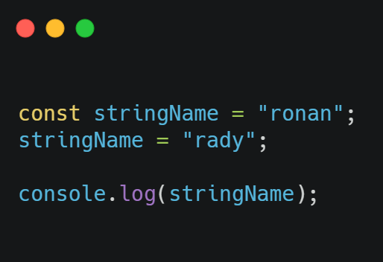
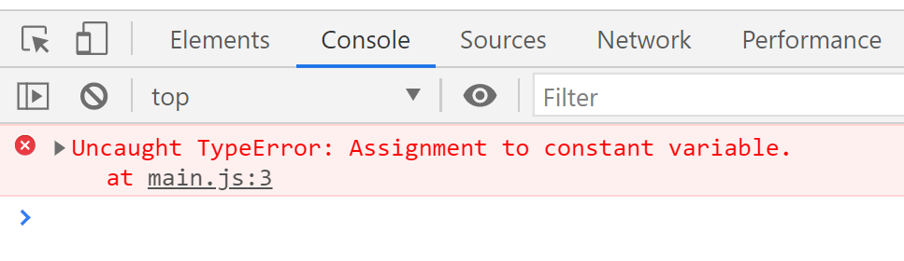
EXPLAIN
Constants in JavaScript
A variable defined with const cannot be reassigned.

Slide 38
What will the console display?
const x = 4
console.log(x)
A
B
C
D
4
5
Syntax error
Runtime error
Notes:
a

Slide 39
What will the console display?
const x = 4
x = 5
console.log(x)
A
B
C
D
4
5
Syntax error
Runtime error
Notes:
d

Slide 40
What will the console display?
const a = 10;
const sum = 0;
if (a < 49) {
sum += 90;
}
console.log(sum)
A
B
C
D
0
90
Syntax error
Runtime error
Notes:
d

Slide 41
What will the console display?
const a = 10;
if (a < 49) {
const sum = 10;
}
console.log(sum)
A
B
C
D
10
45
Syntax error
Runtime error
Notes:
d

Slide 42
What will the console display?
const a = 10;
if (a < 49) {
const sum;
console.log(sum)
}
A
B
C
D
nothing
null
Syntax error
Runtime error

